Slide 1
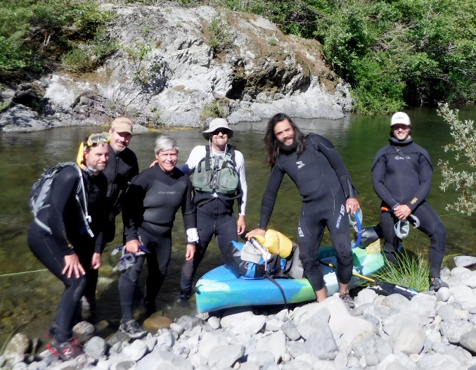
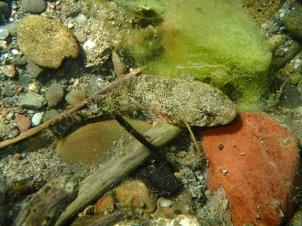
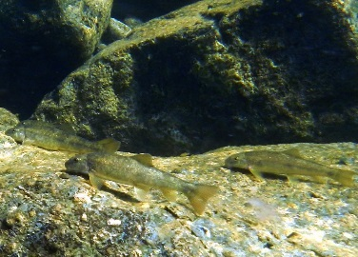
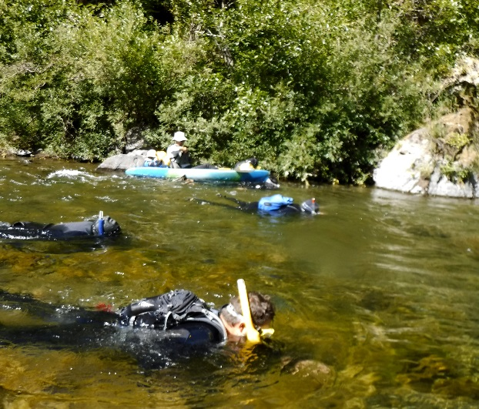
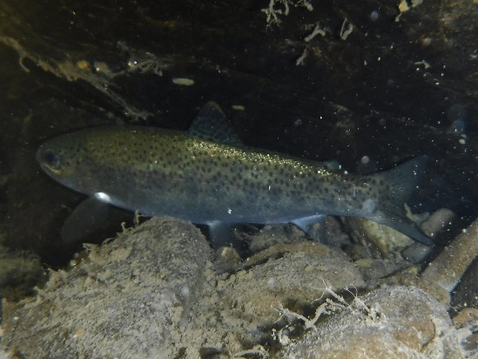
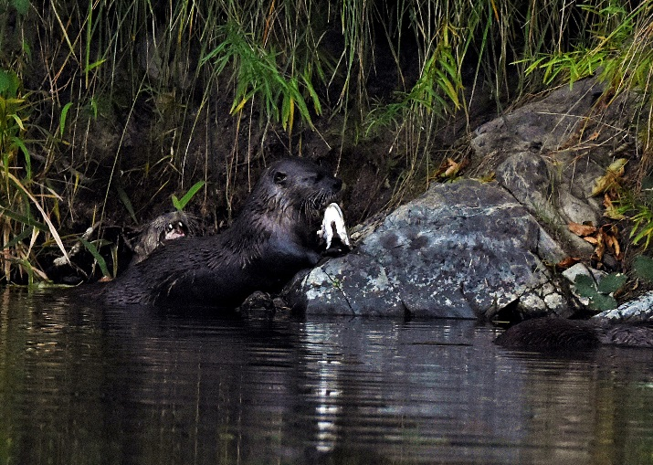
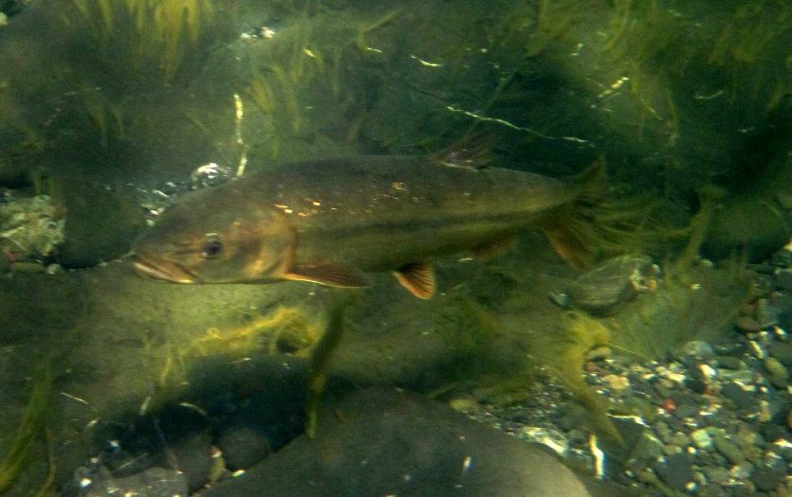
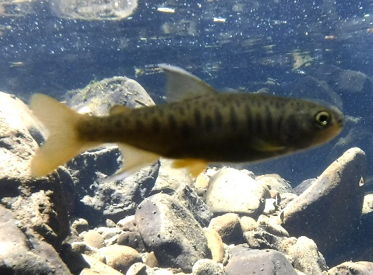
Sacramento Pikeminnow Experimental Control In the South Fork Eel River
By Patrick Higgins, Managing Director Eel River Recovery Project
Presentation to the Eel River Forum
March 27, 2019

Slide 2
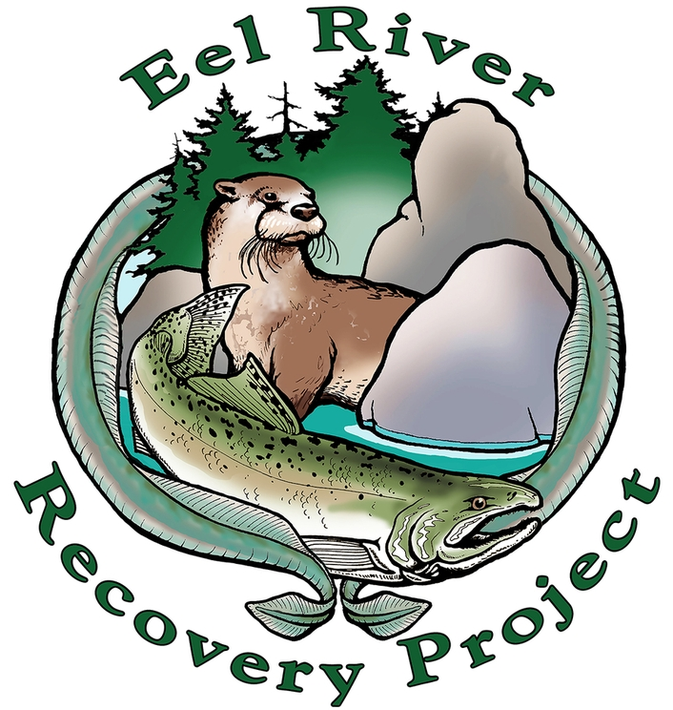
Eel River Recovery Project
Working on Solutions – not an Advocacy Organization
Scope the Community
Identify Needs
Find Resources to Solve Problems
Implement Projects
Monitor Results
Share Back w/Community
Founded in 2011
Engage, Enlighten, Empower
Notes:
15 secs
The Recovery Project came together as a sponsored group of the Trees Foundation in 2012 to help citizens and communities to scientifically gauge the health of the Eel River and to work together to bring the human community within the watershed into Harmony with Nature in order to facilitate ecological restoration.

Slide 3
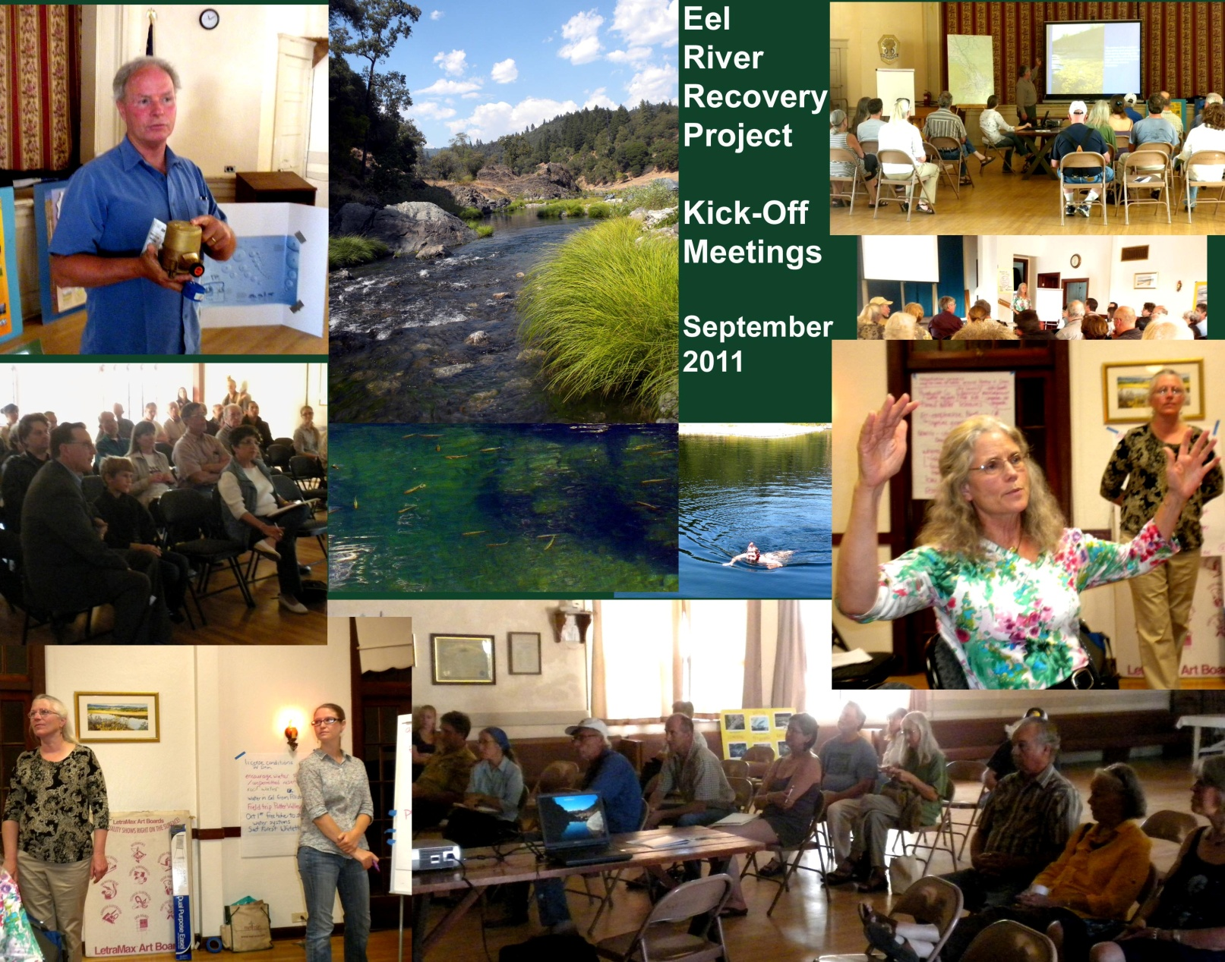
Although requests to control pikeminnow came at our seminal meetings, we did not begin monitoring until 2016 when we received a grant from the Salmon Restoration Association in Fort Bragg.

Slide 4
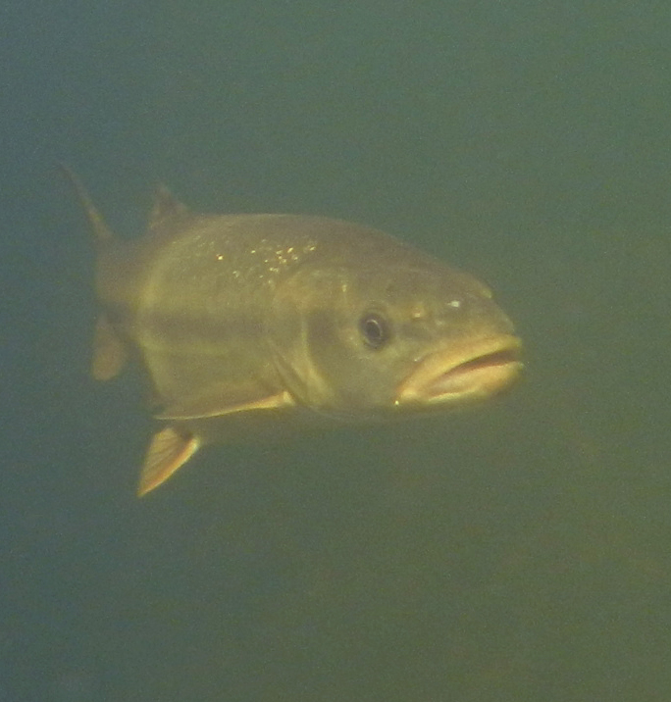
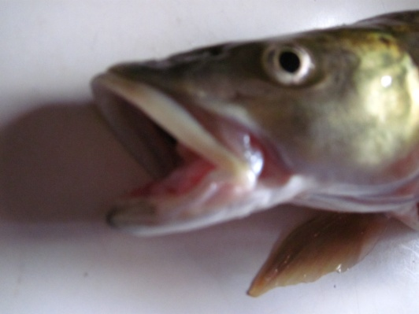
Sacramento pikeminnow (Ptychocheilus grandis) were introduced into the Eel River circa 1979, then proliferated and spread throughout the watershed. There was widespread concern that they could cause native salmonids to go extinct.
ERRP began baseline monitoring of the in the South Fork Eel River in a key reach for threatened and endangered Pacific salmon species in 2016. Trend data have been collected in 2017 and 2018.

Slide 5
Study design forged in consultation with Dr. Bret Harvey of Redwood Sciences Lab
Data provide evidence of substantial predation by Sacramento pikeminnow on steelhead juveniles in the South Fork Eel River near Leggett; therefore, the ERRP index reach is located there.
Baseline data were collected in 2016 using standard dive observation techniques and trend data captured in 2017 and 2018.
ERRP plans continued trend monitoring but would like to get a permit for experimental removal of large adults in 2020, which was also recommended by Dr. Harvey.

Slide 6
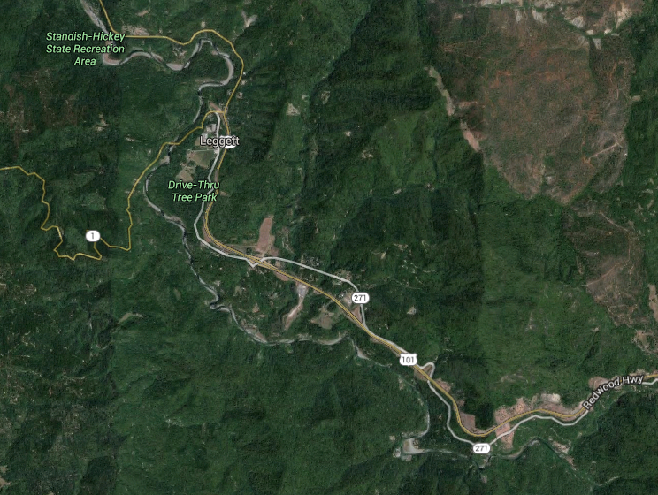
End
Standish-Hickey
Gomde – Halfway
The Hermitage
Start

Slide 7
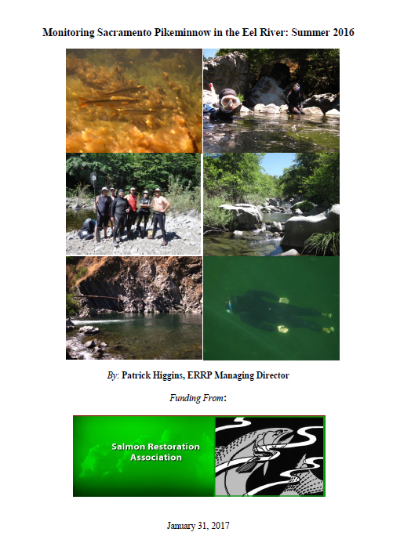

Slide 8
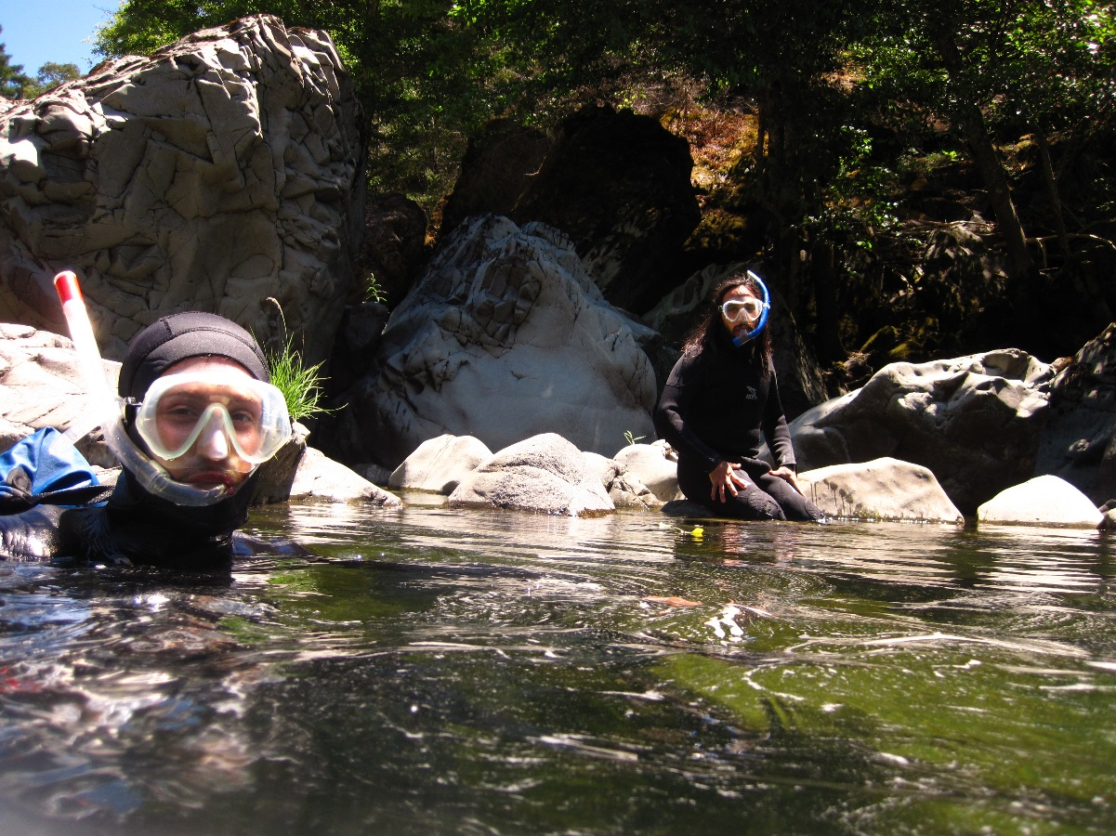

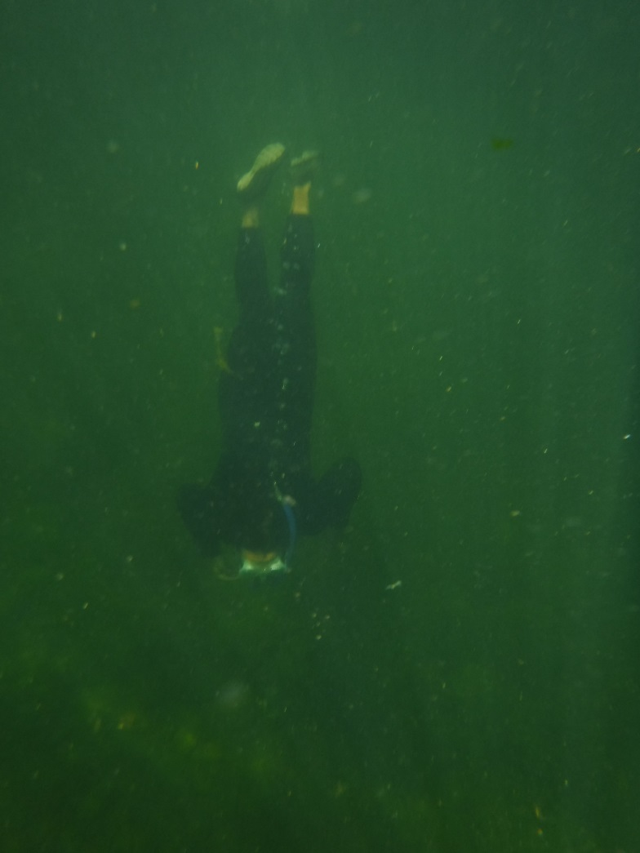
Team of at least 6 divers advances in a line and confirms totals after each unit.
No fish under 4” counted. In 2016 and 2017 size classification was 4-8”, 8-14”, 14-18” and > 18”
Experienced dive crews, UCB, fish biologists, and seasoned ERRP volunteers

Slide 9
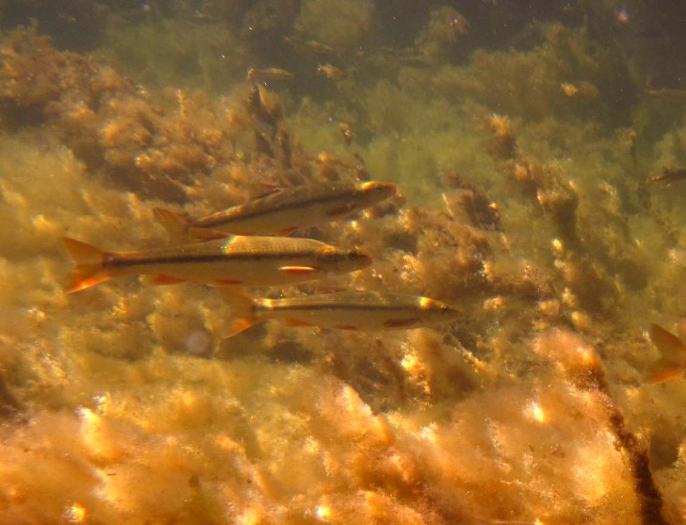

Slide 10
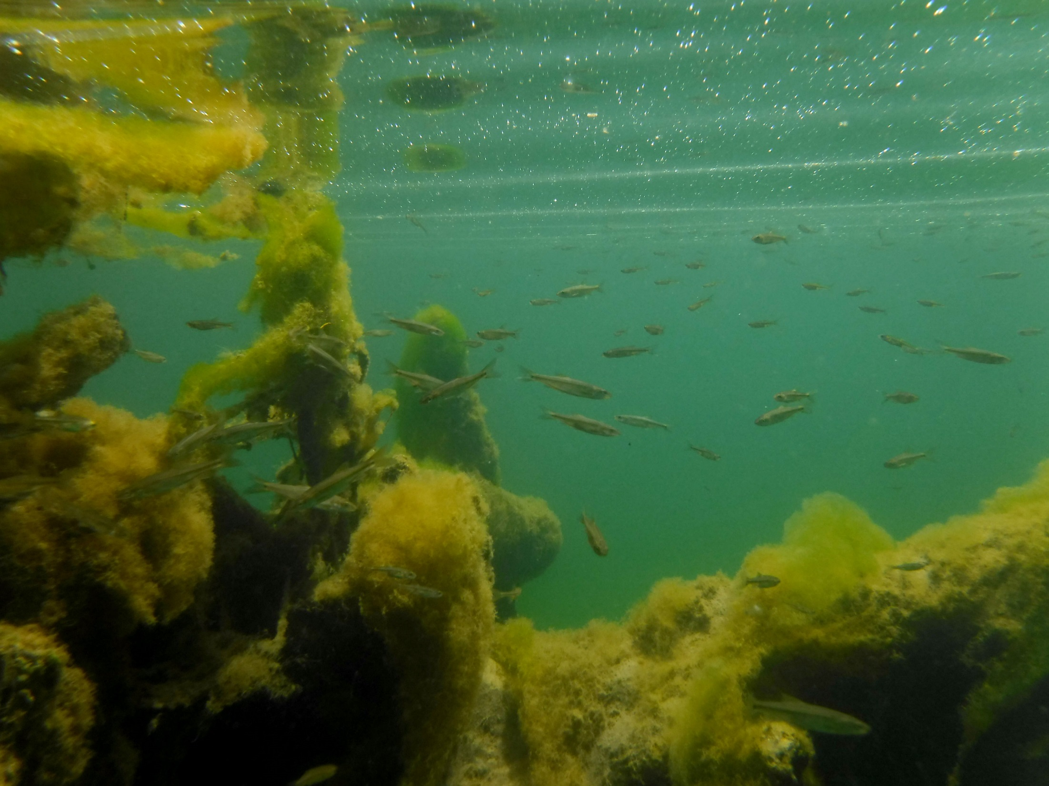

Slide 11
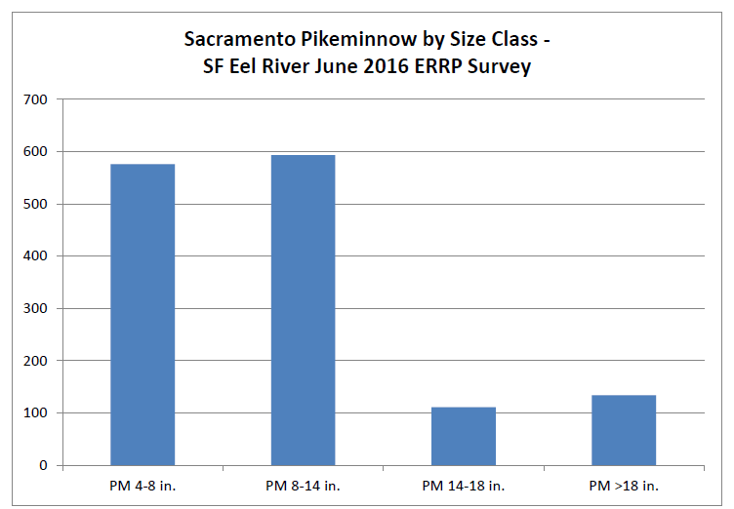
245 > 14”
111
134

Slide 12
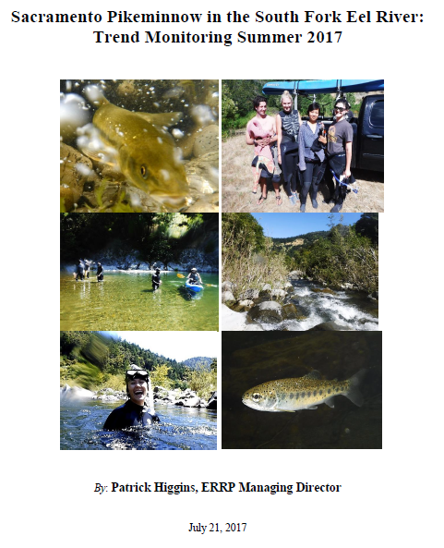

Slide 13
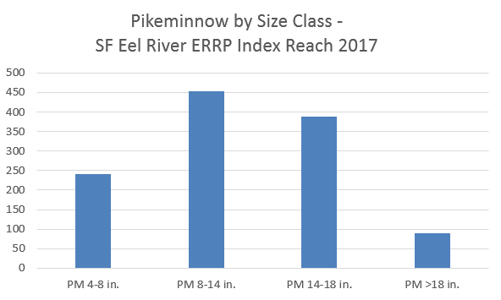
479 > 14”
389
90

Slide 14
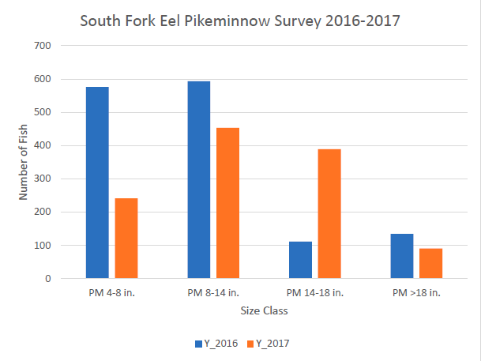

Slide 15
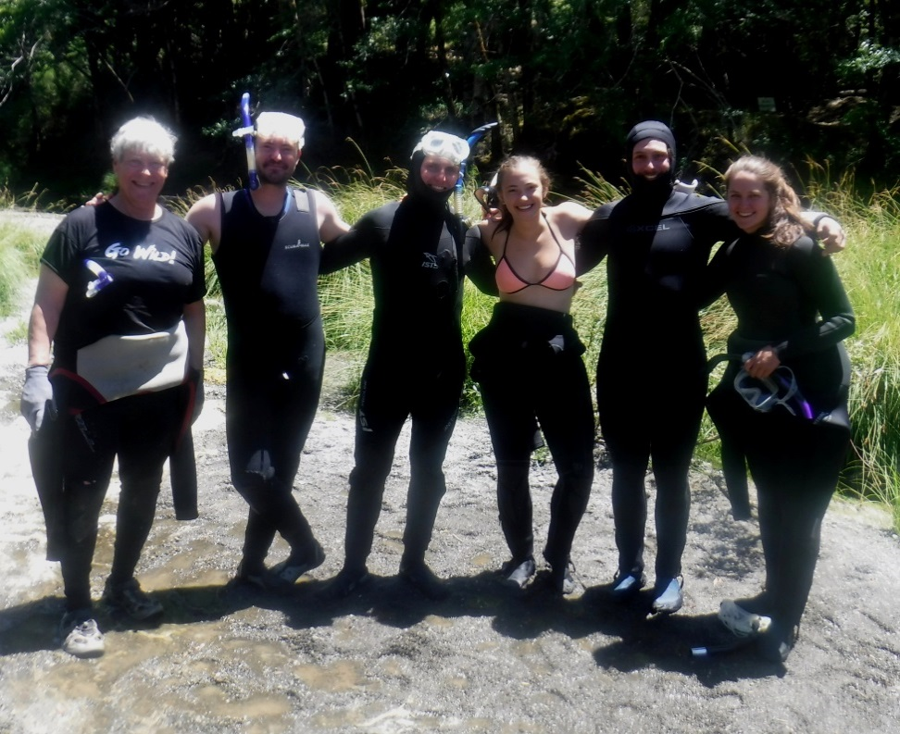
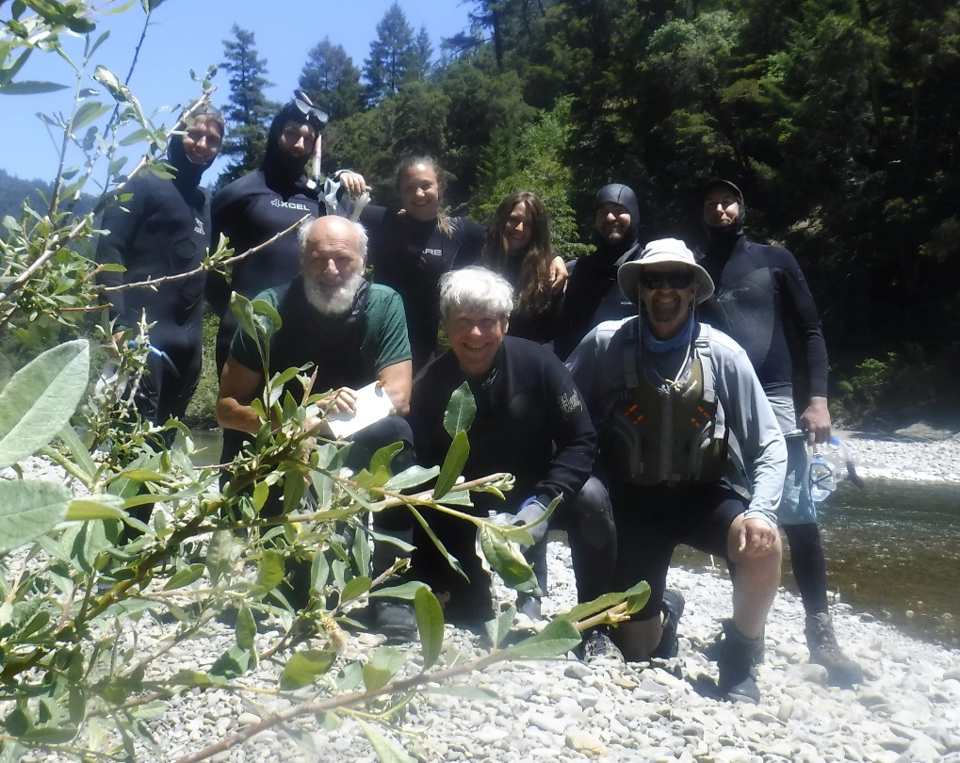
2018 dive protocols changed in terms of size classification: 4-8”, 8-12”, 12-16” and >16 inches
Population remaining the same but demographics reflect high 2013-2015 survival and a increasing numbers of adult pikeminnow >16”

Slide 16
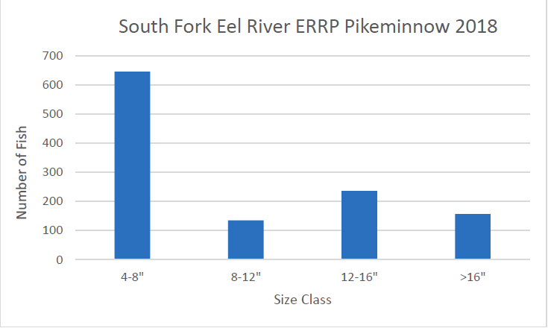
393 > 12”
236
157

Slide 17
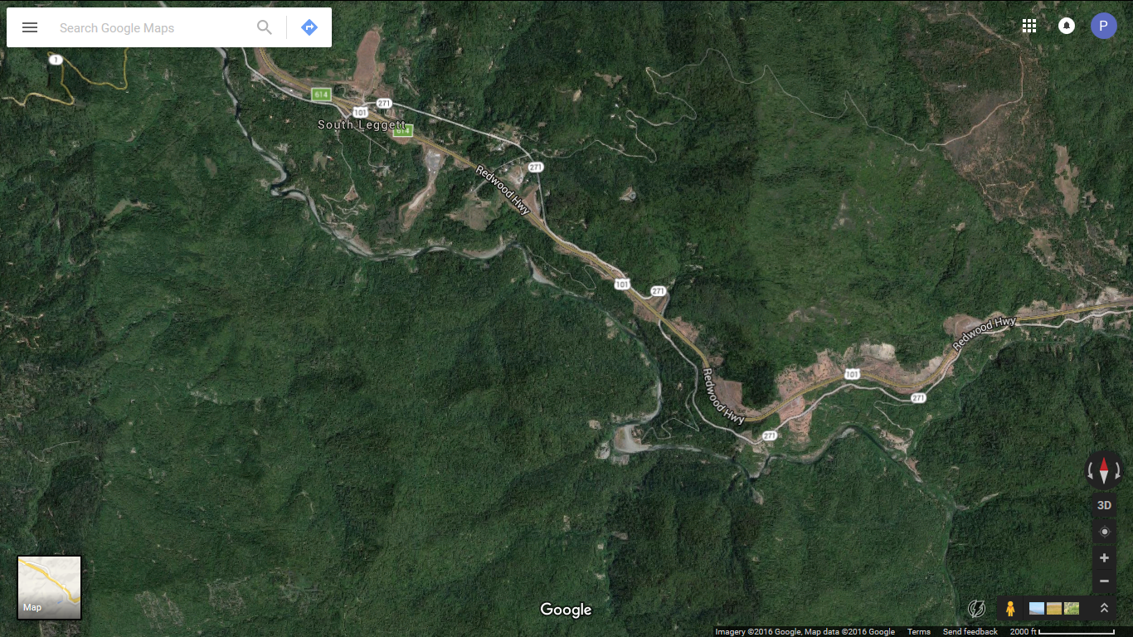
Take Out
Day 1
24 PM
>18”
Put In
26 PM
>18”

Slide 18
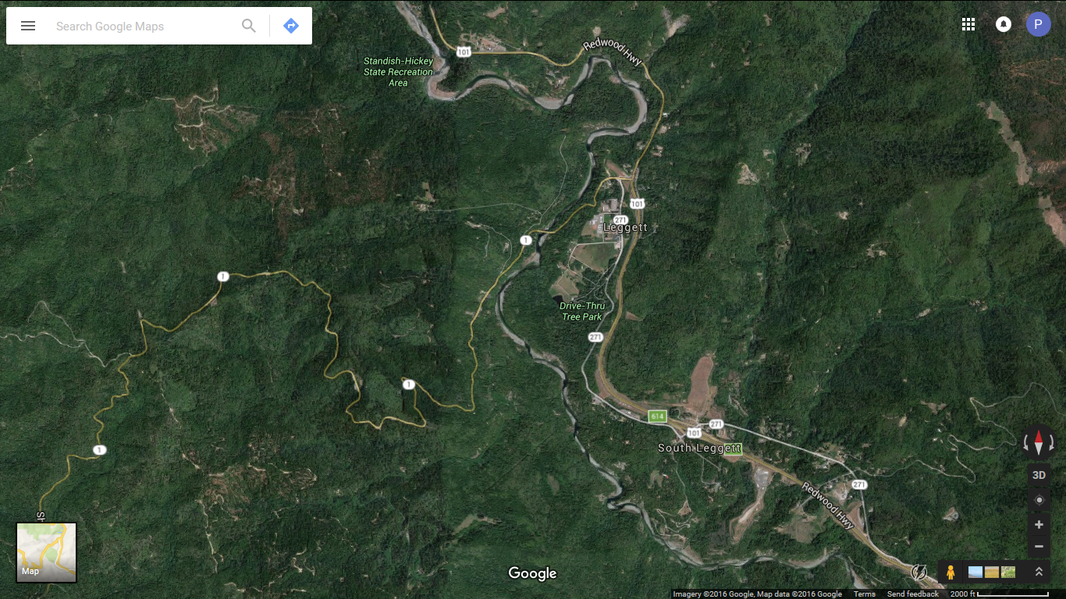
Take Out
Day 2
43 PM
>18”
18 PM
>18”
Put In
Day 2

Slide 19
Findings
Sacramento pikeminnow population over 4” in length ranged from 1173 to 1414 over three years
Strong recruitment during the 2013-2015 drought appears to have lead to an increase in large adults (>16”) as these year-classes matured
Large adult pikeminnow are concentrated in four pools deeper than 25 feet
The restricted number of habitats where large adults are present makes removal by spear fishing feasible
Removal of large adult pikeminnow is desirable to allow recovery of at-risk Pacific salmon species, suckers, sculpin and Pacific lamprey

Slide 20
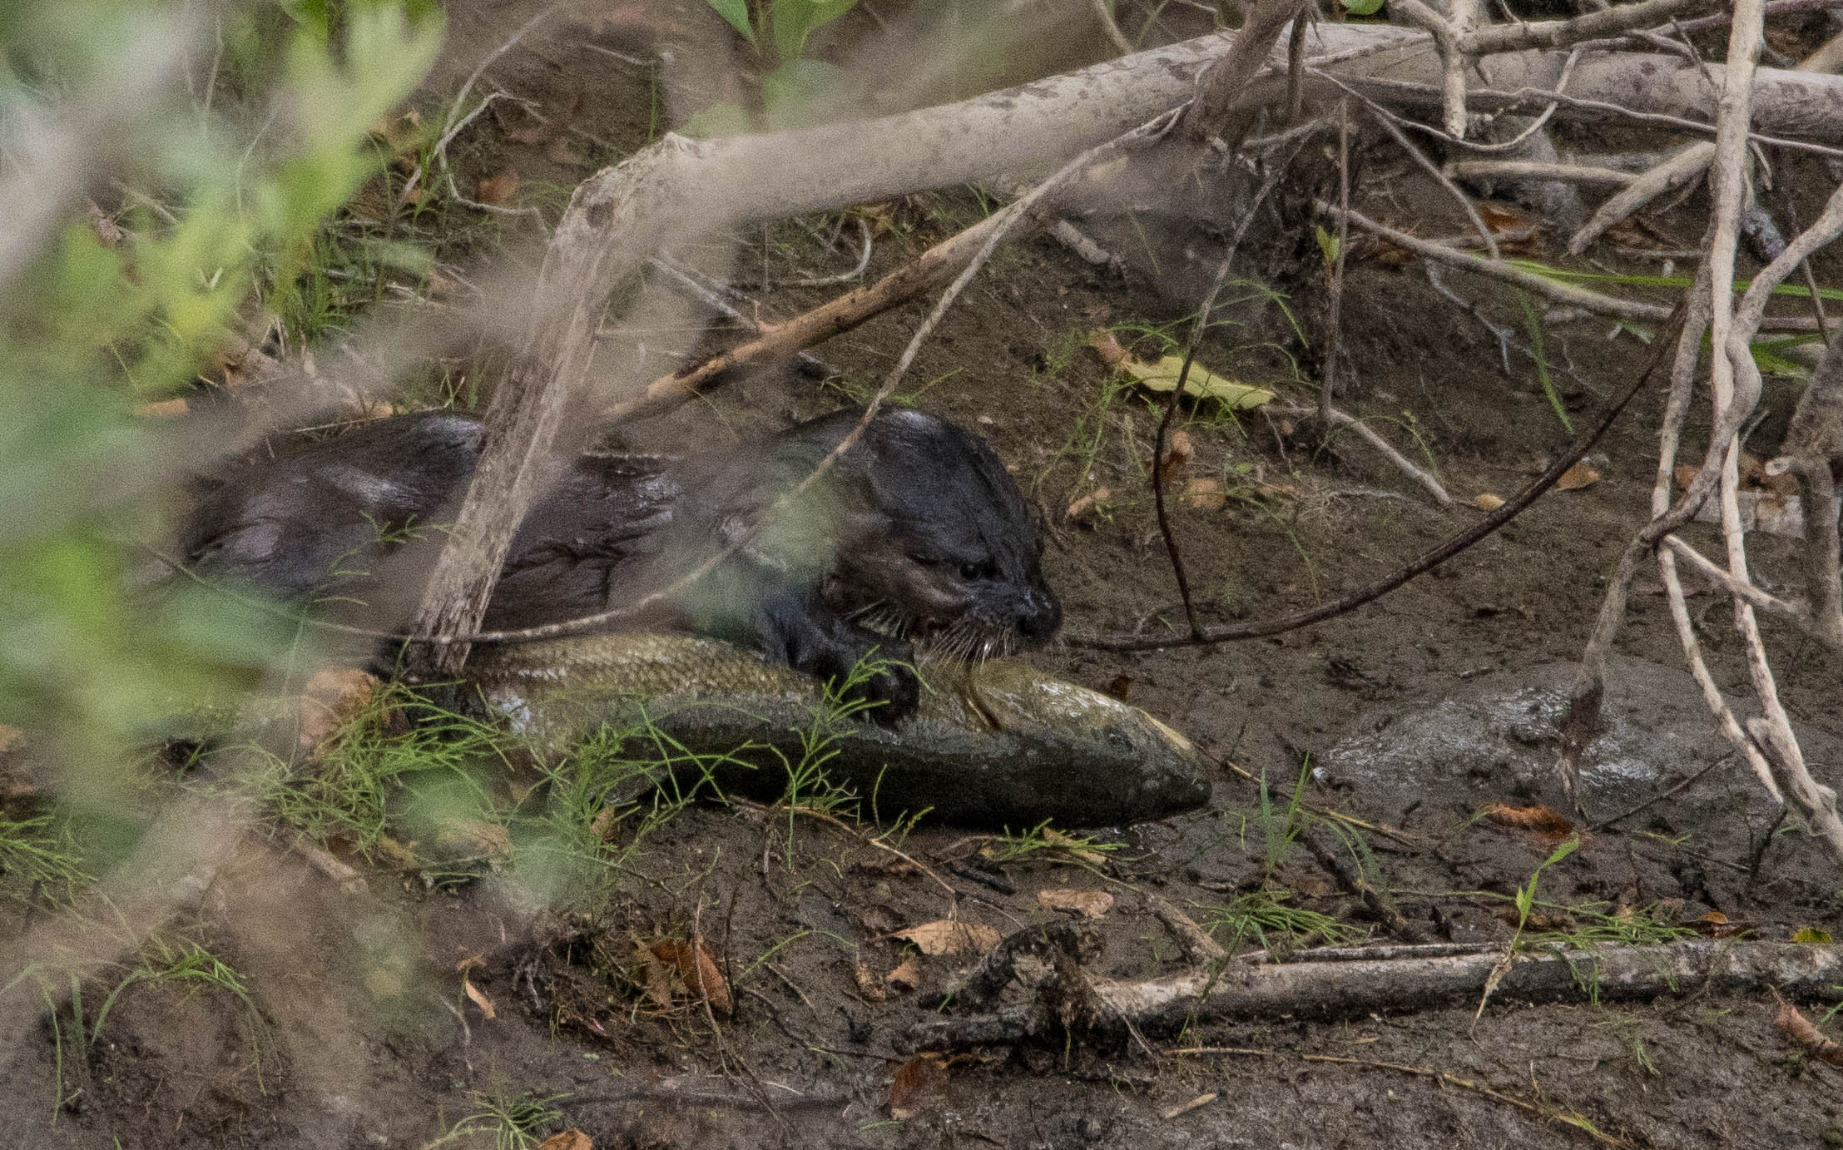
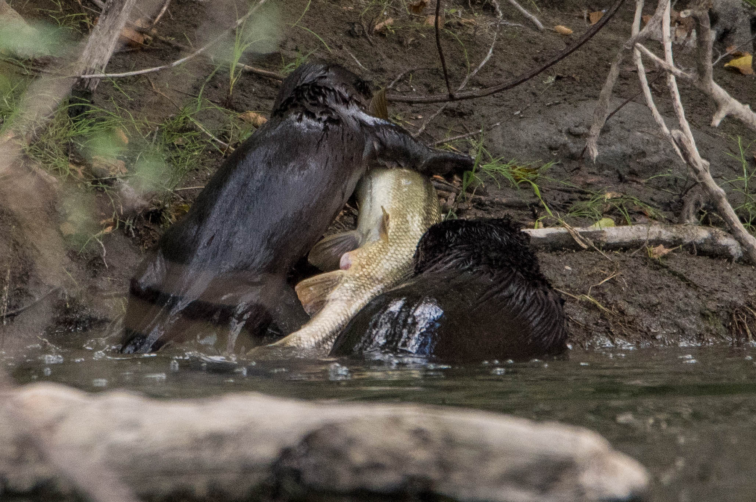

Slide 21
SONCC Coho Recovery Plan Quotes (NMFS 2014)
The non-native Sacramento pikeminnow poses a high threat to coho salmon fry, juveniles, and smolts. Pikeminnow prey on all coho salmon life stages except adults, and also compete with juveniles for limited food and habitat.
Predation by Sacramento pikeminnow is a significant concern in the South Fork Eel River population area, as well as throughout the Eel River watershed.
Addressing Sacramento pikeminnow and the quality of the Eel River estuary as well as other actions to improve the migratory corridors for the South Fork Eel population are top priority.

Slide 22
Benefits of Removal of Large Pikeminnow
Removal of large pikeminnow will substantially reduce predation on ESA listed juvenile salmonids similar to the findings of Riemen and Bermesdefer (1990).
They predicted that a 20% reduction in the population of large adult pikeminnow could reduce the predation on migrating salmon and steelhead juveniles by 50%.
If we harvest 100 adult pikeminnow greater than 16 inches, that would be more than a 50% reduction of the largest adults in the reach.
If each adult eats 300 salmonids/year = +30,000
1000 salmonids/year = +100,000
Other native fish species need relief from predation.

Slide 23
ERRP applying for a “Special Use” CDFW Scientific Collector’s Permit (SCP) for Pikeminnow Removal
Eradicate adult pikeminnow >16” in four pools in SF Eel River index reach beginning in 2020
Conduct annual collection/removal over a two-day period during low flow conditions so adult pikeminnow are concentrated in pools, but before deteriorated water quality (swimmer’s itch) (July 15-August 15)
Erect block nets to prevent large pikeminnow escape
Continue annual removal for 10 years
Continue to conduct trend monitoring dives in the last week of June annually
Provide data for adaptive management

Slide 24
Justification for Scientific Collector’s Permit
Purpose
The Sacramento pikeminnow is an “Inland non-anadromous fish” that is not native to the Eel River. Our target will be adults greater than 16 inches in length in order to suppress predation of salmon and steelhead juveniles and other native fish species in the upper South Fork Eel River. A secondary objective is to knock down reproductive ability of pikeminnow as larger adults are usually females, and the larger the female the more fecund.

Slide 25
Collection Location
ERRP is focused on a 12 mile reach of the upper South Fork Eel River because of concerns raised by Dr. Bret Harvey about predation by pikeminnow on salmonids there. The reach extends from the Hermitage at the mouth of Rattlesnake Creek to Standish Hickey State Park. ERRP baseline and trend data (2016-2018) found that 80% of large adult pikeminnow were residing in just four pools that were 25 feet deep or more in the 12 mile reach. Therefore, collection will be limited to those pools.

Slide 26
Methods/Techniques
Our preferred method is spear-fishing because it is highly selective and we can target large adult pikeminnow exclusively. ERRP is a volunteer driven organization and trained spearfishermen that can dive for several minutes and to a depth of greater than 30 feet are ready to participate. They would use spears like the Hawaiian sling or other designs to target large adult pikeminnow in the four deepest pools in our 12 mile long index reach. Block nets will be set up at the top and bottom of each pool unit to prevent adult pikeminnow from escaping.

Slide 27
Species and Number Collected
Only Sacramento pikeminnow will be harvested and only those over 16 inches in length will be targeted because they are both the most significant predators and also the most fecund. The likely upper limit of our catch would not be more than 200 adult pikeminnow greater than 16 inches.

Slide 28
Section 1801 – CA Fish & Game Code
States that one valid use of an SCP is:
“Removal of non-native, invasive, or detrimental wildlife to improve or restore ecosystem or habitat conditions, or otherwise enhance the sustainability of native wildlife or other species.”

Slide 29
Conclusion
Although ERRP observations indicate a downturn in the Sacramento pikeminnow population relative to the 1990s (Clancy 1993), there is always the potential for the population to re-expand in the future unless they are managed. Intervention is imperative, because prior human activities, like building a reservoir suitable for pikeminnow proliferation and introducing them, have put the native fish community of the Eel River under stress. There is greater risk of harm to salmonid and native fish populations from inaction than from possible side-effects of pikeminnow removal and management of the species.

Slide 30
“It is as if man had been suddenly appointed managing director of the biggest business of all, the business of evolution – appointed without being asked if he wanted it, and without preparation. What is more, he can’t refuse the job. Whether he wants to or not, whether he is conscious of what he is doing or not, he is in fact determining the future direction of evolution on this earth. That is his inescapable destiny, and the sooner he realizes it and starts believing in it, the better off for all.”
- Julian Huxley

Slide 31
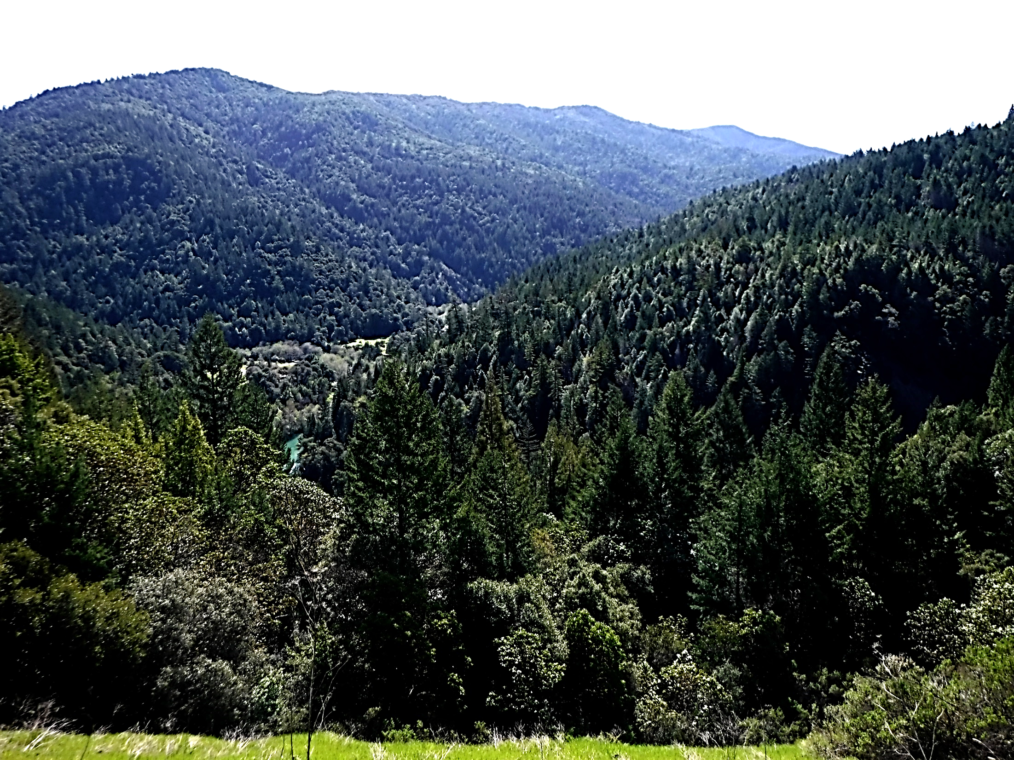
QUESTIONS?

