Slide 1
Eel River Pikeminnow: Basic Stuff
Bret Harvey
USFS Redwood Sciences Lab, Arcata

Slide 2
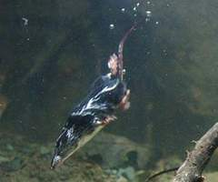
What’s a shrew got to do with it?

Slide 3
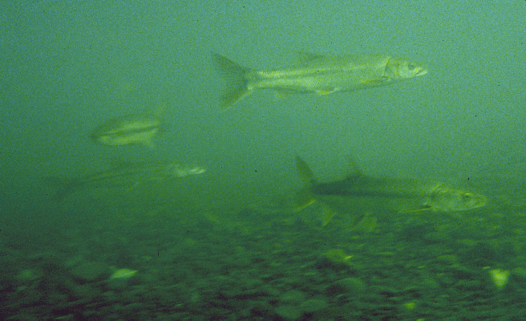
Life History?

Slide 4
They get big
Lots of eggs
Really big ones in the Eel probably about 6 – 7 years old
Coexist with salmonids elsewhere in CA
MAY eat lots of trout and salmon in some places – often at human-built structures
Notes:
>4 feet, 32 lbs, >15000 eggs

Slide 5
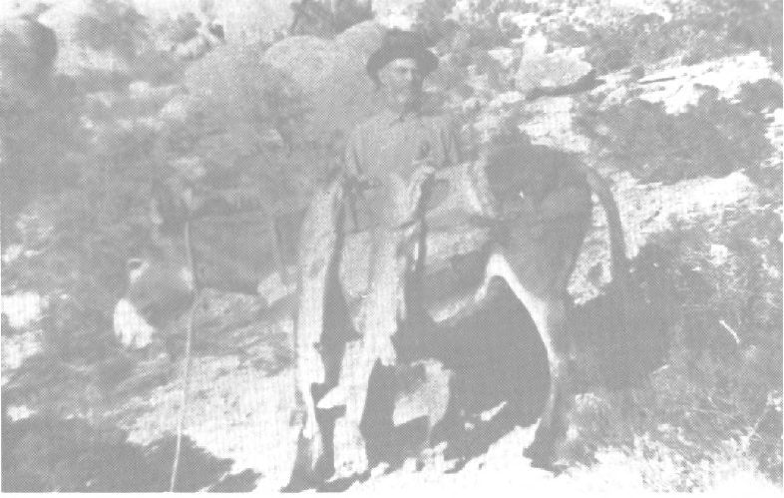

Slide 6
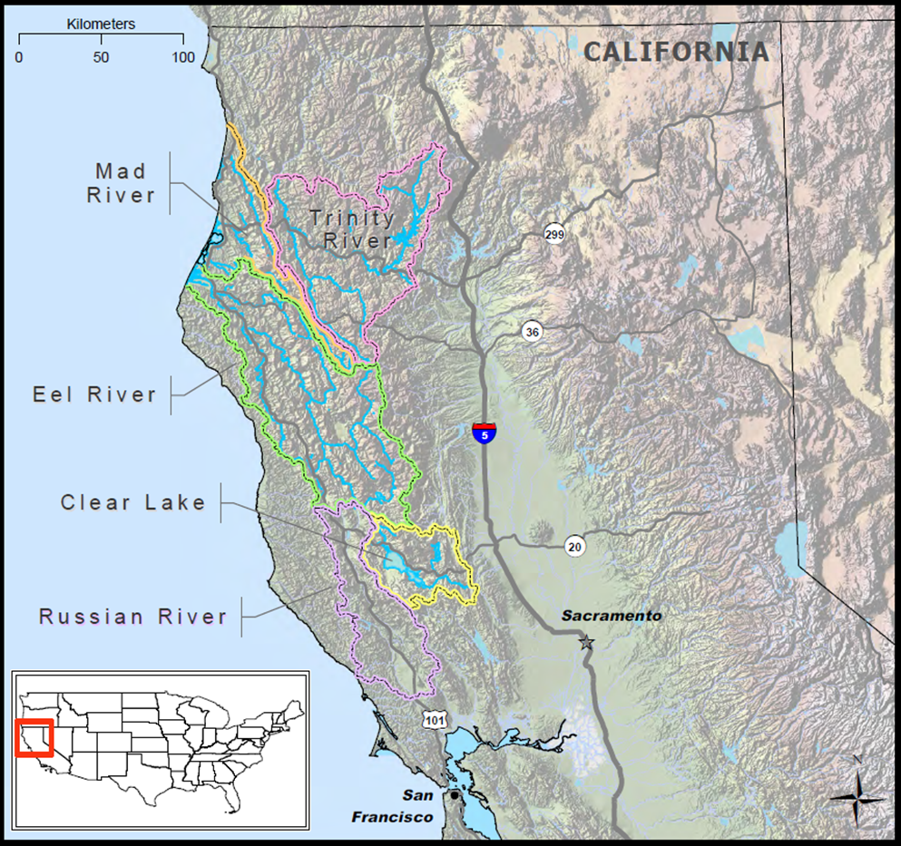
Origin?

Slide 7
Diet?

Slide 8
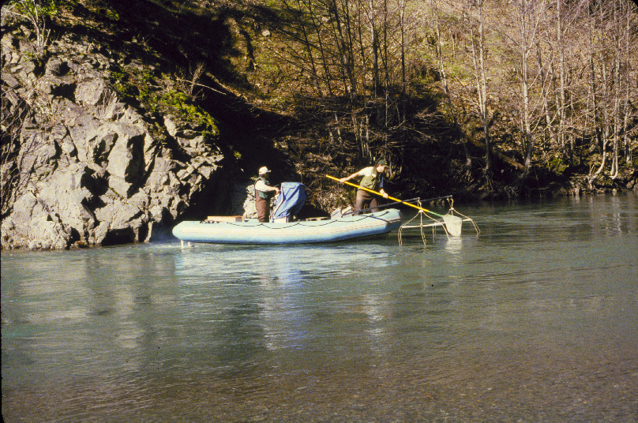

Slide 9
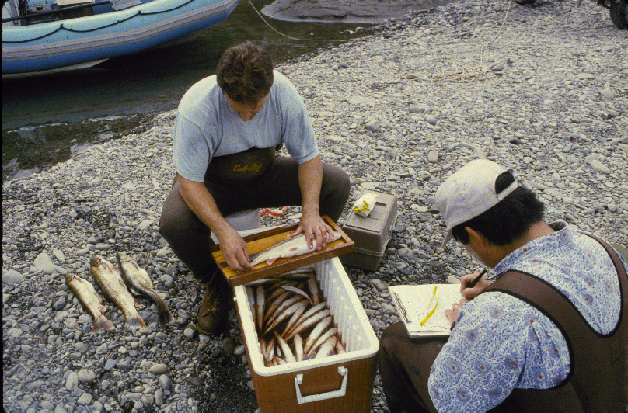

Slide 10
1.00
insects
fish
miscellaneous
0.80
0.60
Proportion of Diet (wet weight)
0.40
0.20
0
<100
101-150
151-200
201-250
251-300
301-350
351-400
>400
Standard Length (mm)
n =
101
213
320
294
130
65
64
32

Slide 11
Pikeminnow Diet Composition by % Weight
misc. aquatic insects
misc.
Coleoptera
Diptera
Ephemeroptera
salmonids
Hemiptera
lamprey
stickleback
roach
Odonata
pikeminnow
Plecoptera
sculpins
Trichoptera
suckers
terrestrial insects
unidentified fishes

Slide 12
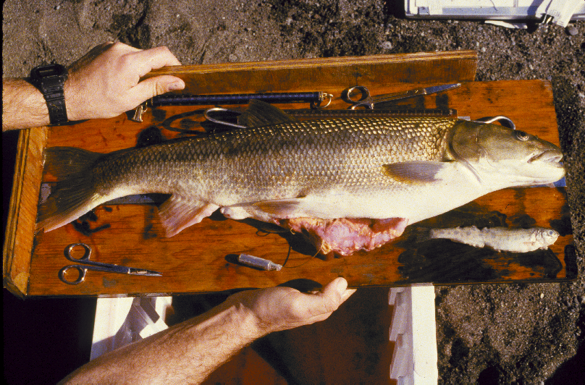

Slide 13
Competition with salmonids?

Slide 14
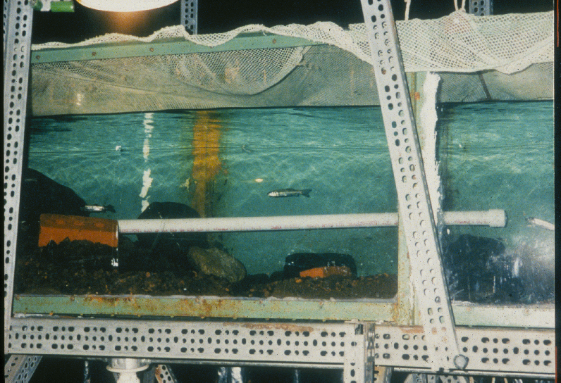

Slide 15
@ 17 C (62°F): no influence on steelhead
@ 22 C (71°F): equal competitors with steelhead

Slide 16
Distribution?

Slide 17
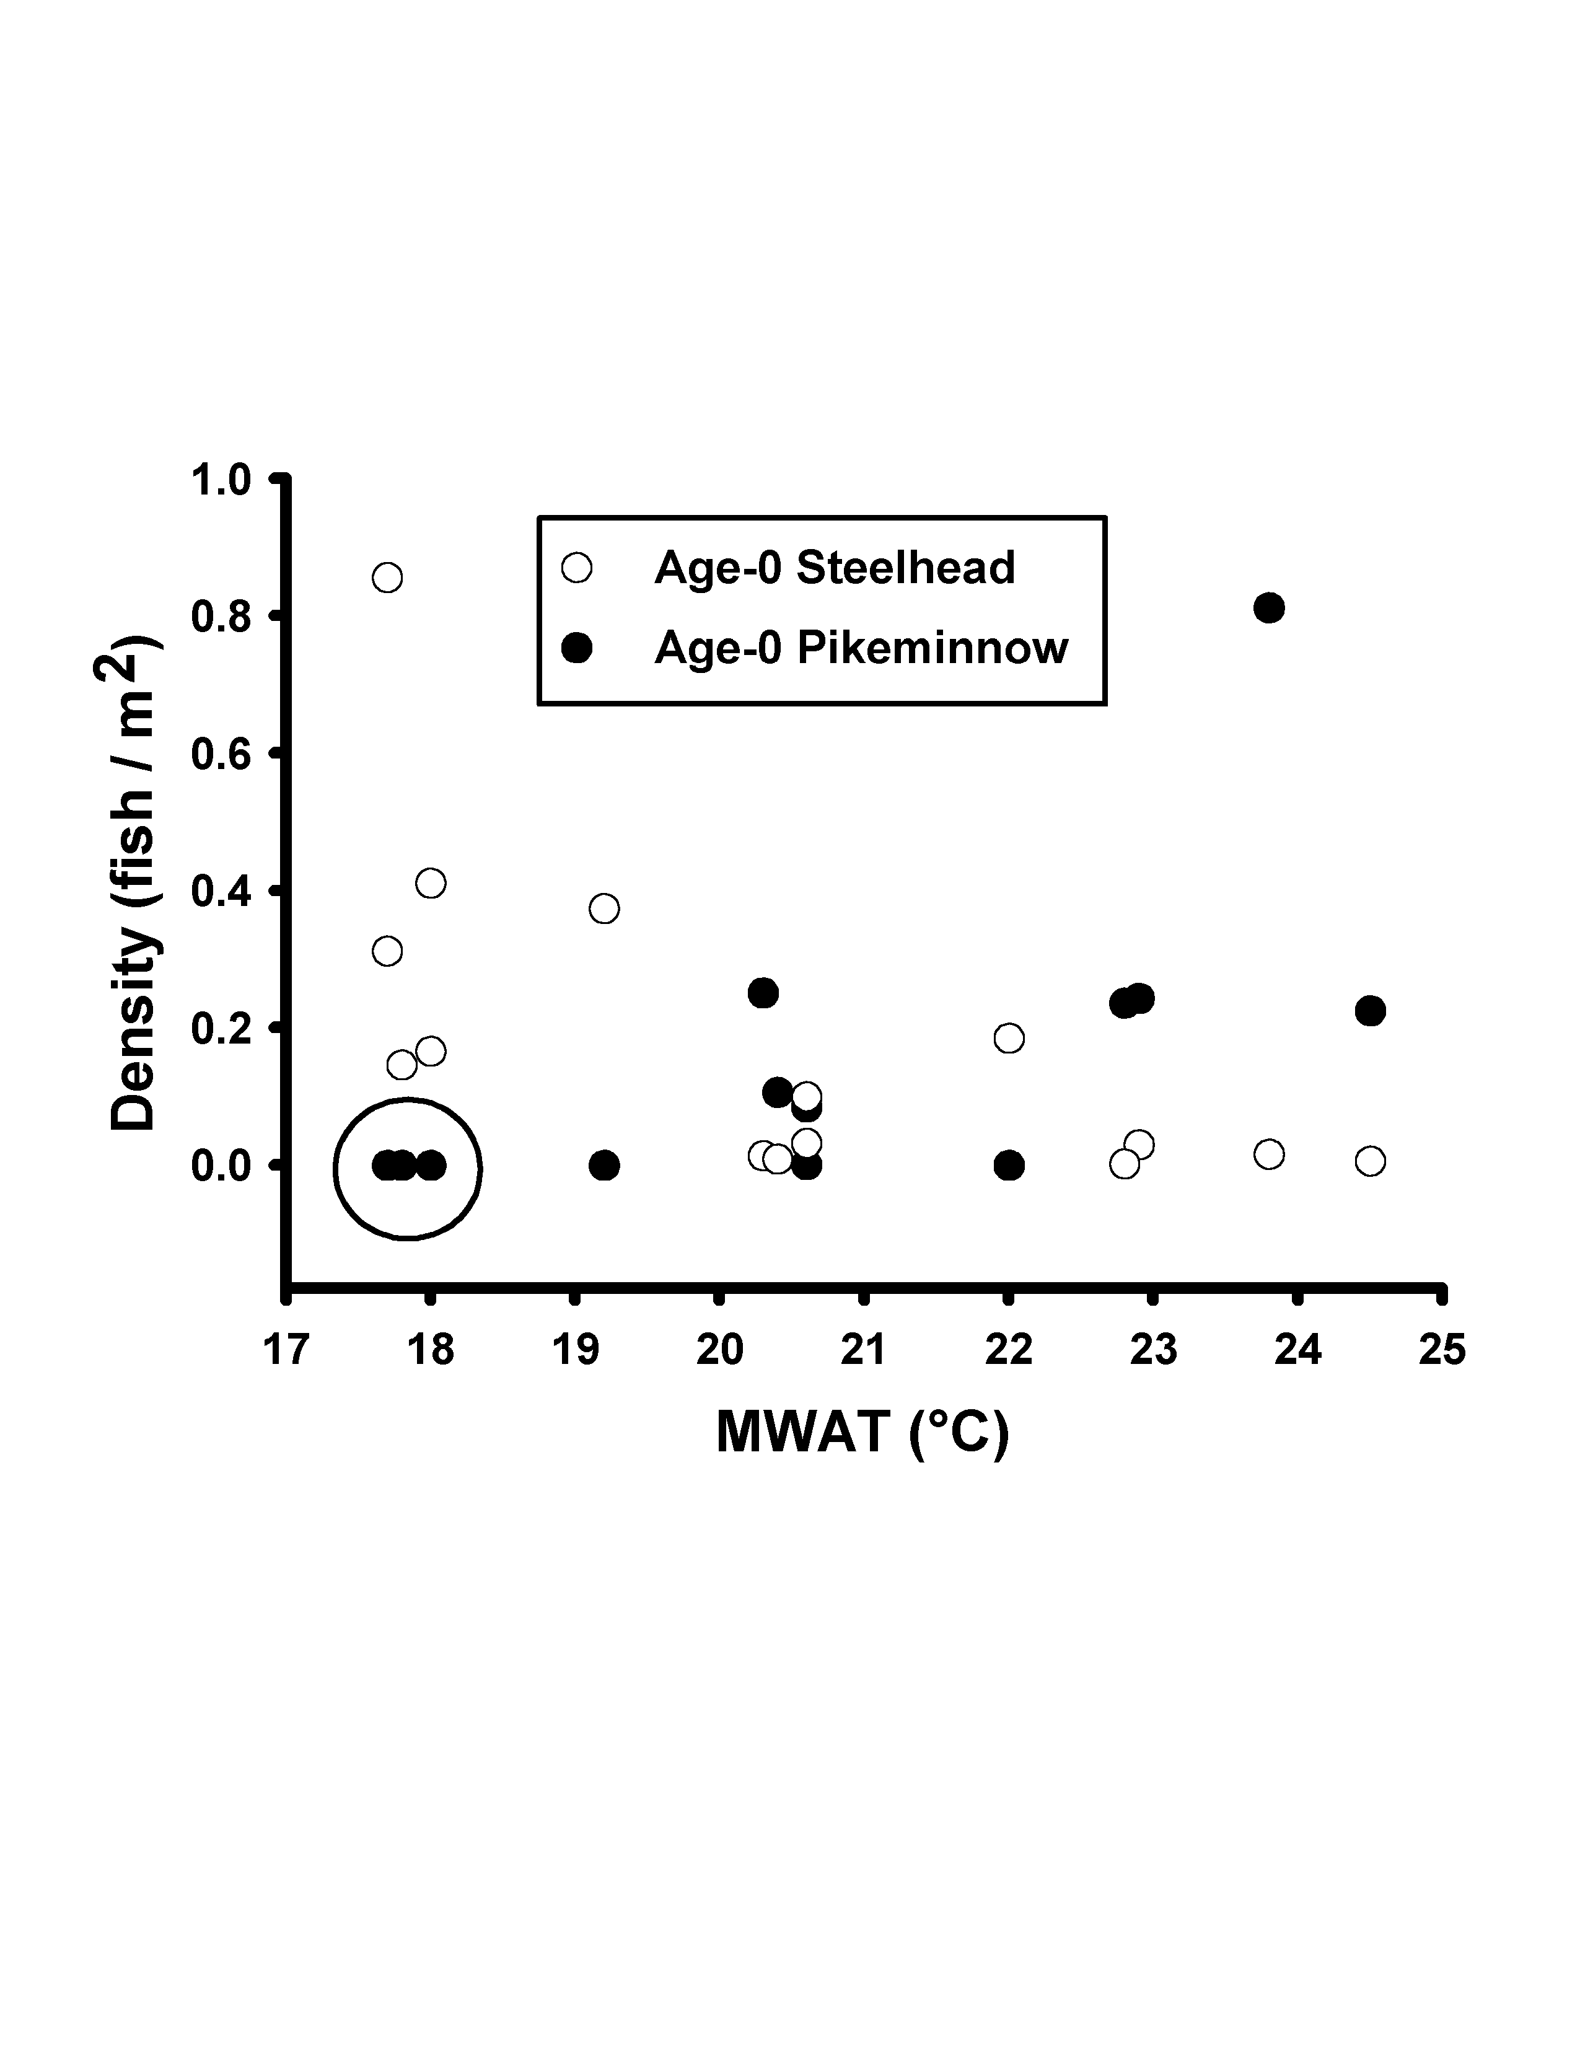
Pikeminnow use warm tributaries

Slide 18
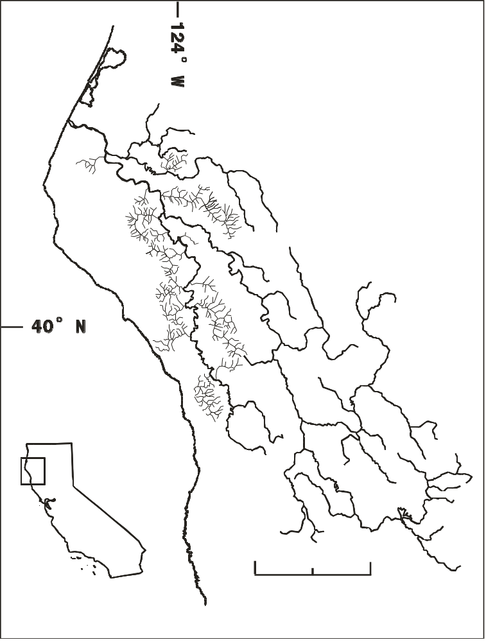
*
*
*
*
*
Spawning?

Slide 19

Movement?

Slide 20
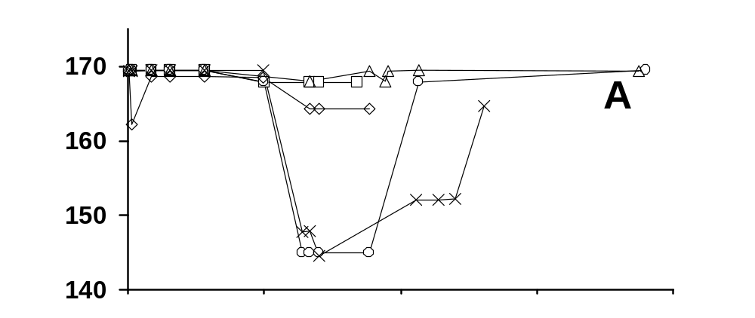
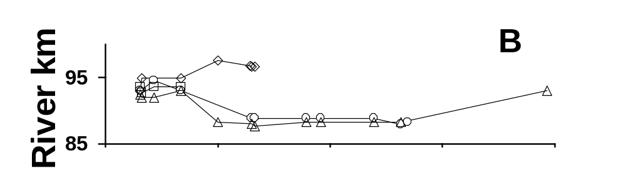
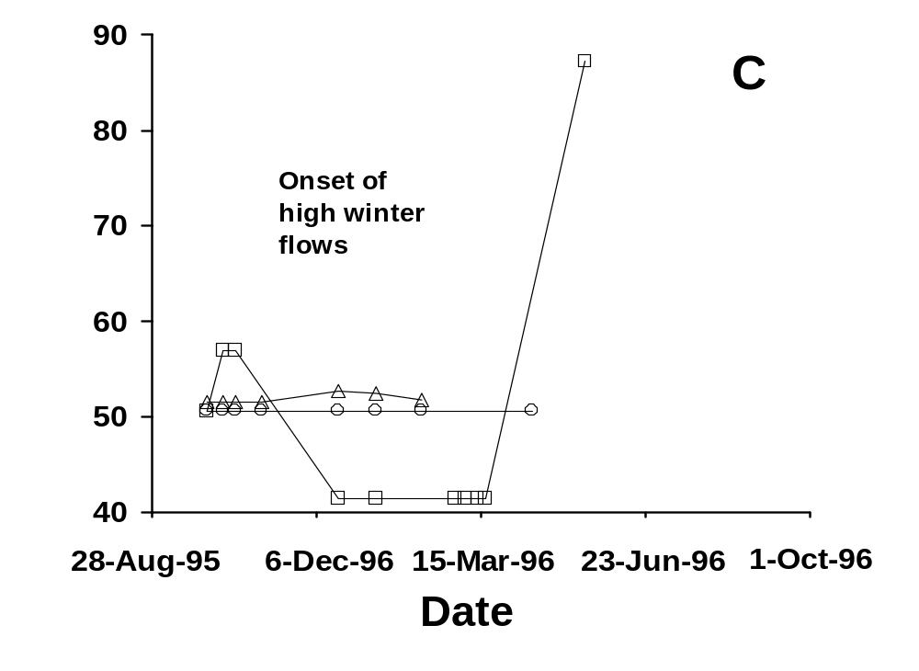
Standish-Hickey
Miranda
Shively

Slide 21
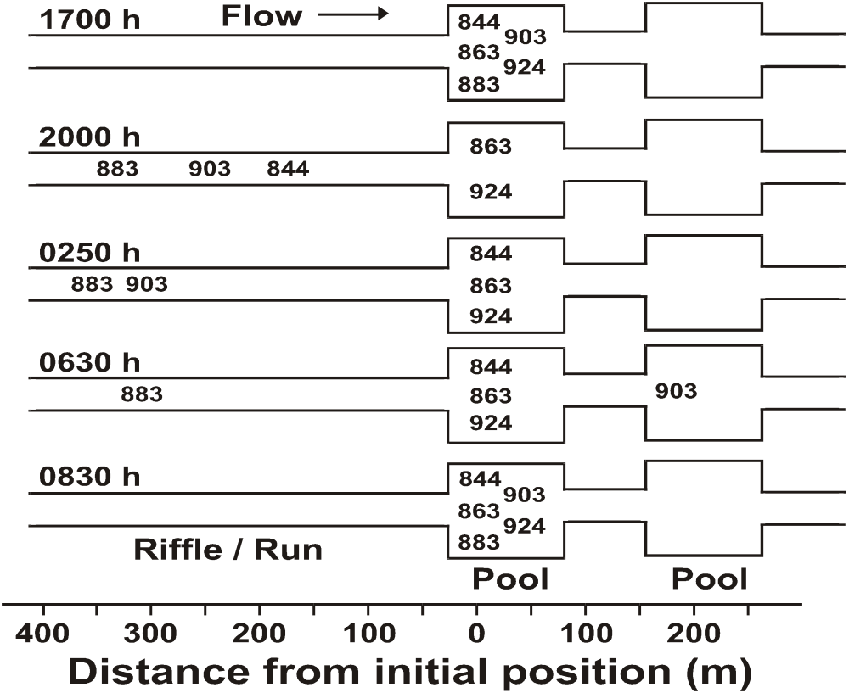
Night moves at Standish-Hickey…

Slide 22
Thanks,
It’s Over
Pikeminnow papers here:
http://users.humboldt.edu/bcharvey/publications.html

